Slide 1
Webinar Series
CIOMS Working Group XIII consensus report on
Real-world data and real-world
evidence in regulatory decision making
Dr Lembit Rägo Secretary-General, Council for International Organizations of Medical Sciences (CIOMS)
Geneva, Switzerland
ragol@cioms.ch

Slide 2

CIOMS Working Group XIII consensus report on
Real-world data and real-world evidence in regulatory decision making
CIOMS – Introduction (https://cioms.ch/ )
Council for
International
Organizations of
Medical
Sciences (41 member organizations)
Founded in 1949 by WHO and UNESCO
In official relations with WHO
UNESCO associated partner
ICH Observer since 2016
Mission Statement
CIOMS mission is to advance public health through guidance on health research including ethics, medical product development and safety

Slide 3
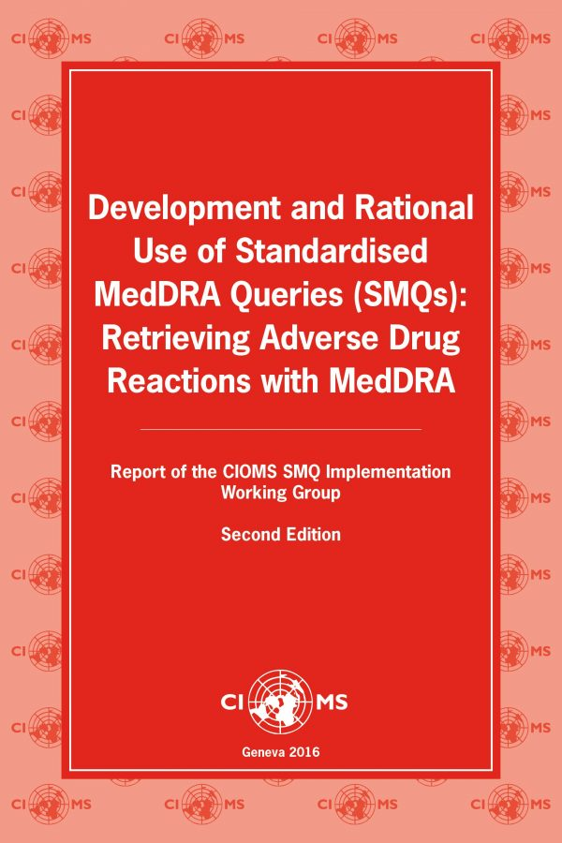
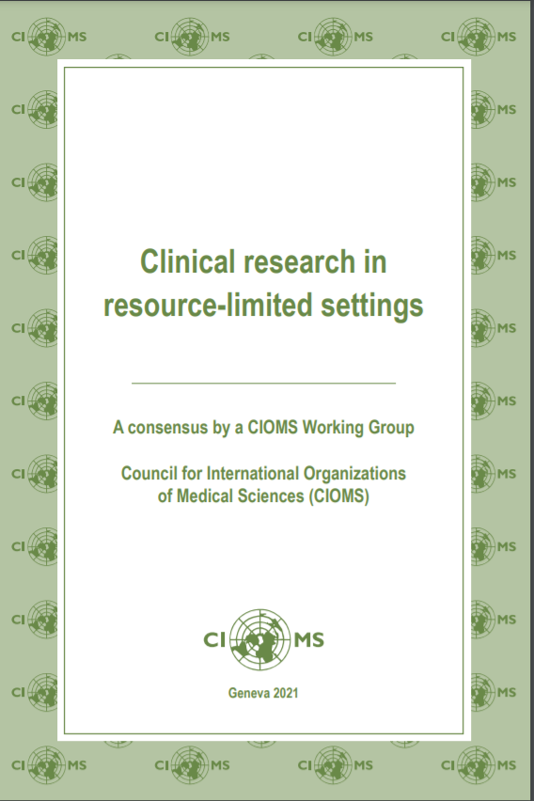
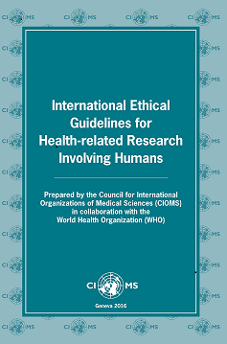
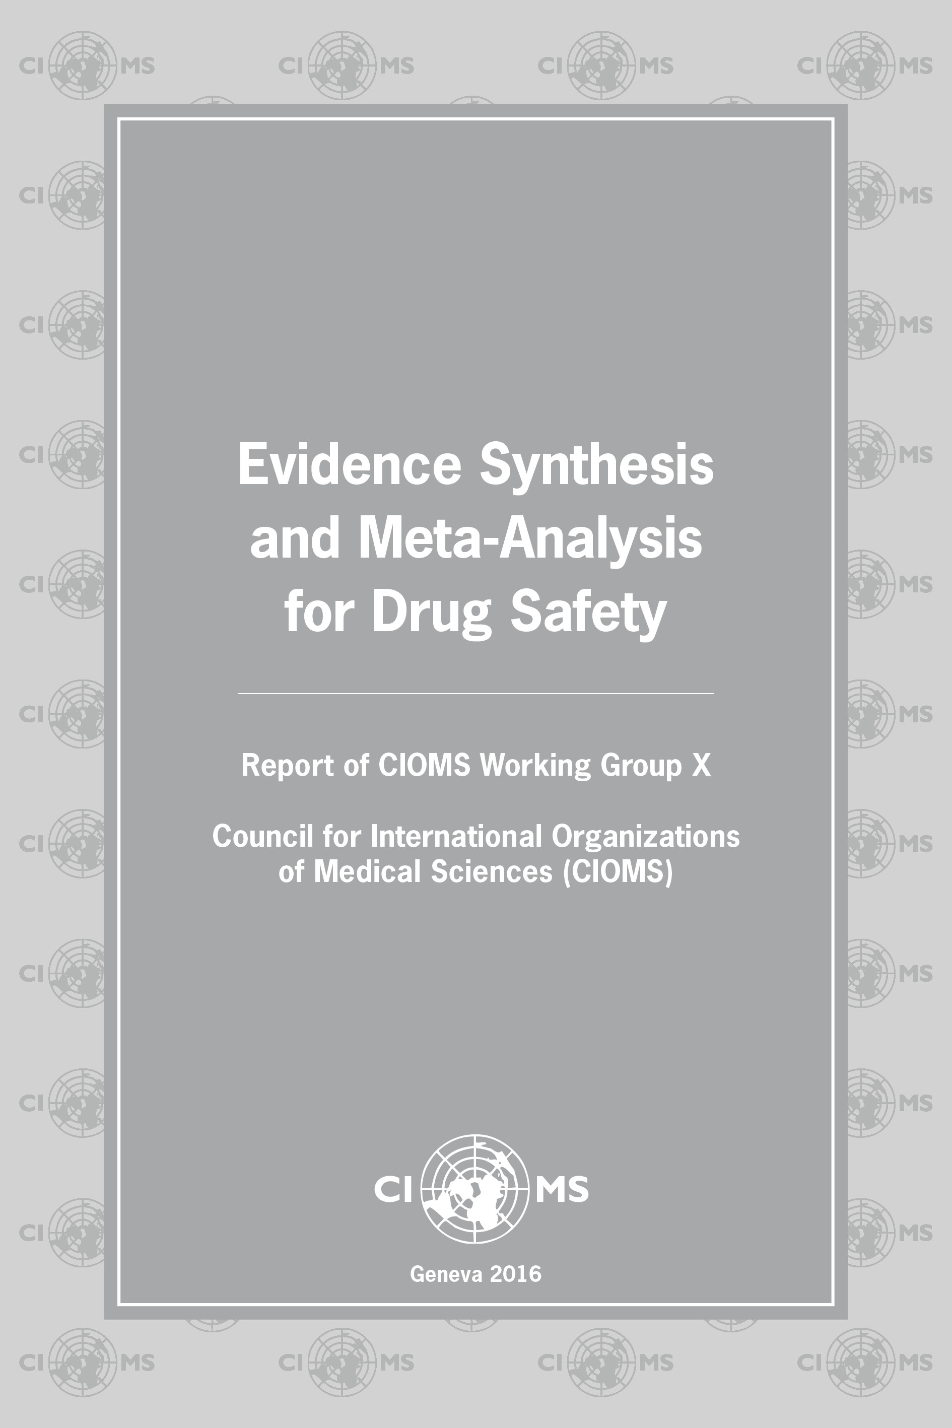

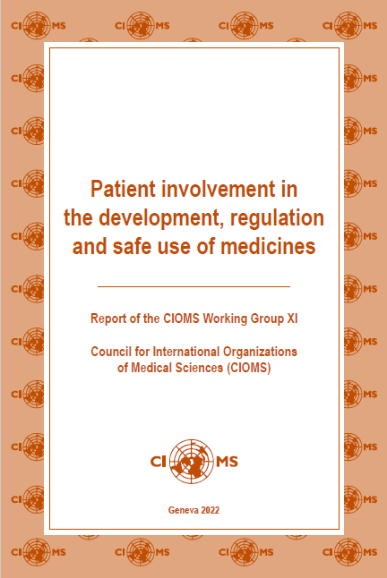

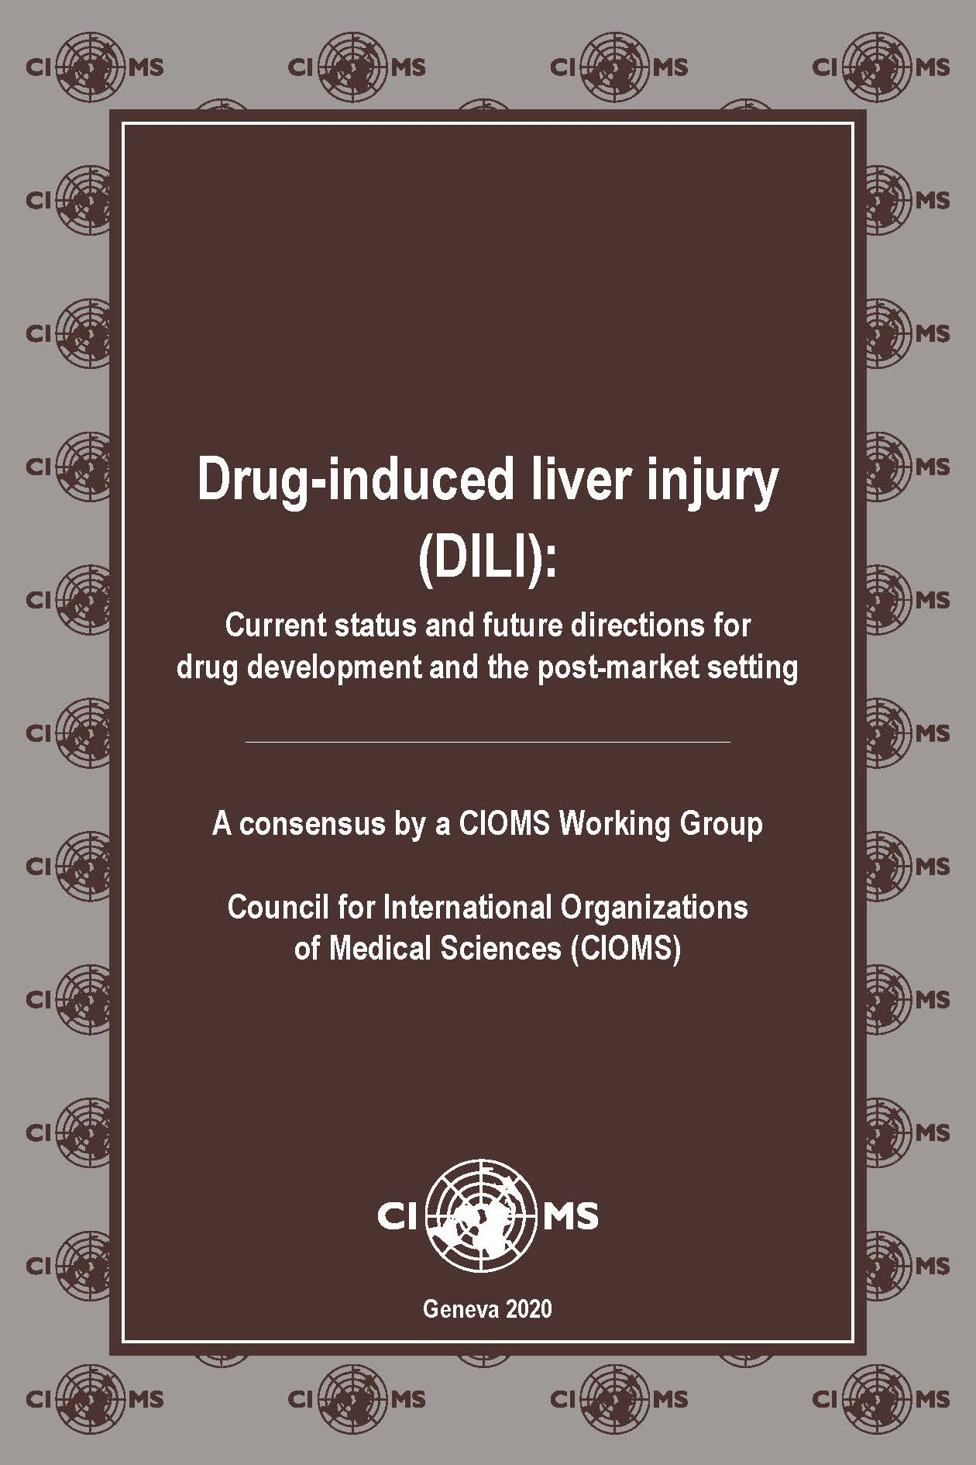

CIOMS Working Group XIII consensus report on Real-world data and real-world evidence in regulatory decision making
Product
development
Main areas of work (more at https://cioms.ch/
Bioethics
Pharmaco-vigilance
Since 1977
CIOMS Round Table Conference, ‘Trends and Prospects in Drug Research and Development’ ….
2021: Clinical Research in Resource-Limited Settings, CIOMS Working Group report
2022: WG XI Report on Patient Involvement and Glossary of ICH terms and definitions
Since 1977
CIOMS Round Table Conference, ‘Trends and Prospects in Drug Research and Development’ ….
2021: Clinical Research in Resource-Limited Settings, CIOMS Working Group report
2022: WG XI Report on Patient Involvement and Glossary of ICH terms and definitions
Since 1967; 1st CIOMS Round Table Conference ‘Biomedical Science and the dilemma of Human Experimentation’
Issued significant guidelines
CIOMS 2016 Ethical Guidelines Available in 10+ languages, e.g. Chinese, Portugue, Spanish, Arabic, Japanesese, Ukrainian
Since 1967; 1st CIOMS Round Table Conference ‘Biomedical Science and the dilemma of Human Experimentation’
Issued significant guidelines
CIOMS 2016 Ethical Guidelines Available in 10+ languages, e.g. Chinese, Spanish, Arabic, Japanese, Portuguese, Ukrainian
1986: first PV Working Group
13 more working group reports to date
Several ICH Guidelines are based on results of CIOMS Working Groups
Cumulative Glossary 2021*

Slide 4

CIOMS Working Group XIII consensus report on Real-world data and real-world evidence in regulatory decision making
CIOMS Ongoing Working Groups in 2024
Benefit-Risk Balance for Medicinal Products.
CIOMS WG XII. Started September 2019 *
Real-World Data and Real-World Evidence in
Regulatory Decision-Making. CIOMS WG XIII.
Started March 2020 – May 2024
Severe Cutaneous Adverse Reactions (SCARs).
Started February 2021 *
Recommended Standards of Education and Training for Health
Professionals Participating in Medicines Development. Started April 2021
Artificial Intelligence in Pharmacovigilance. CIOMS WG XIV. Started May 2022
Pharmacoepidemiology for Public Health Decision Making, CIOMS WG XV. Started November 2023
In-person participants at the 9th Meeting of CIOMS WG XIV
* Final report expected in 3Q-4Q 2024

Slide 5
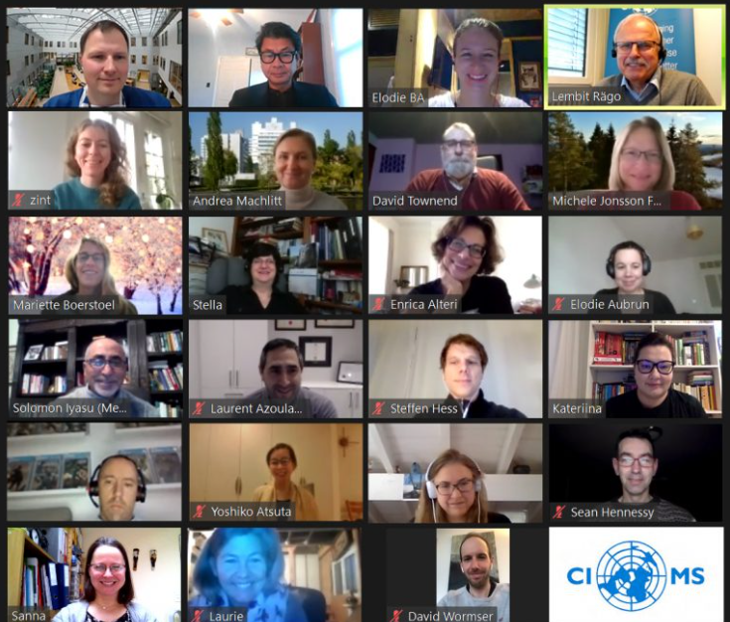
CIOMS Working Group XIII consensus report on Real-world data and real-world evidence in regulatory decision making
CIOMS WG XIII - RWD and RWE in regulatory decision making
CIOMS International WG XIII was composed of experts from academia, industry and regulators.
The WG XIII 1st meeting (virtual) was held on 30 March 2020.
Since then, it had 17 (only) virtual meetings. First (and last) in-person meeting was during 4-5 October 2023 in Geneva.
As a rule, CIOMS WG meeting minutes are public.
Public consultation of the draft report in 2023 resulted in 900+ comments.

Slide 6
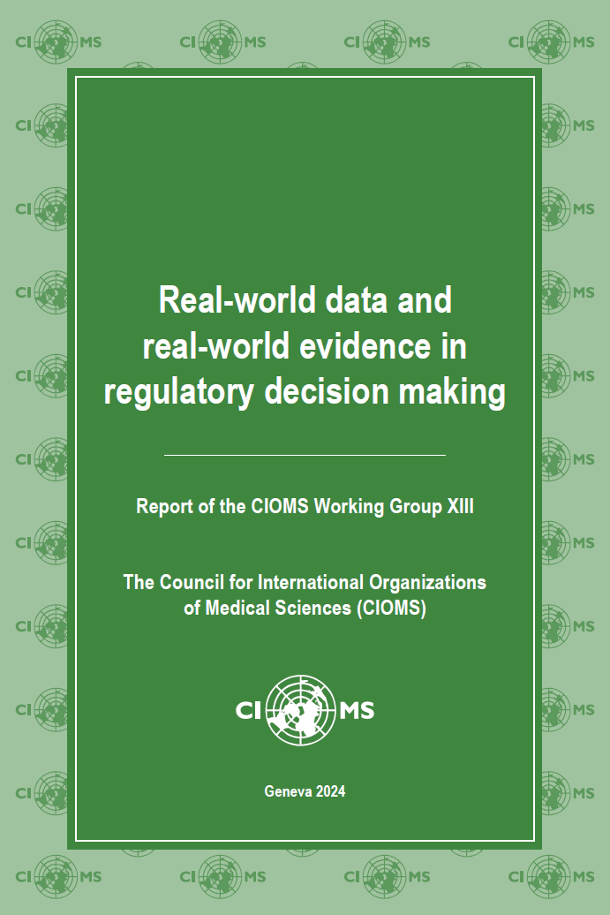
CIOMS Working Group XIII consensus report on Real-world data and real-world evidence in regulatory decision making
Report content (123 pages):
Preface
Executive summary
Introduction
Chapter 1: Real-world evidence for decision making during the product lifecycle
Chapter 2: Sources of real-world data
Chapter 3: Real-world evidence for regulatory use: key considerations
Chapter 4: Ethics and governance
Chapter 5: Conclusions and future directions
Appendices: Case studies (A to H, 8) ICMRA statement on international collaboration to enable real-world evidence (RWE) for regulatory decision-making CIOMS Working Group membership and meetings List of public consultation commentators
https://doi.org/10.56759/kfxh6213
https://cioms.ch/publications/

Slide 7
CIOMS Working Group XIII consensus report on Real-world data and real-world evidence in regulatory decision making
No Glossary – but some definitions
Organisation | Definition of Real-World Data (RWD)
US Food and Drug Administration (FDA) | Data relating to patient health status and/or the delivery of health care routinely collected from a variety of sources. Examples of RWD include data derived from electronic health records, medical claims data, data from product or disease registries, and data gathered from other sources (such as digital health technologies) that can inform on health status.
European Medicines Agency (EMA) | Routinely collected data relating to a patient’s health status or the delivery of health care from a variety of sources other than traditional clinical trials.
Joint International Society for Pharmacoepidemiology (ISPE) – International Society for Pharmacoeconomics and Outcomes Research (ISPOR) Special Task Force on Real-World Evidence in Health Care Decision Making | Data obtained outside the context of randomized controlled trials (RCTs) generated during routine clinical practice.
International Society for Pharmacoeconomics and Outcomes Research (ISPOR) | Data relating to areas such as patient health status and/or healthcare delivery not collected in conventional RCTs. Examples of RWD are electronic health records (EHRs); wearables; medical claims data; surveys; and product, patient, and disease registries.
RAND corporation | Data collected during the routine delivery of care and its reimbursement. This type of data, referred to as real-world data, includes patient registries, electronic health records (EHRs), healthcare claims databases, and patient-generated data and is defined by its production outside of a research study.
Innovative Medicines Initiative Get Real Project | An umbrella term for data regarding the effects of health interventions (e.g. safety, effectiveness, resource use, etc.) that are not collected in the context of highly-controlled RCT’s. Instead, RWD can either be primary research data collected in a manner which reflects how interventions would be used in routine clinical practice or secondary research data derived from routinely collected data. Data collected include, but are not limited to, clinical and economic outcomes, patient-reported outcomes (PRO) and health-related quality of life (HRQoL). RWD can be obtained from many sources including patient registries, electronic medical records, and claims databases.
* Bate A, Juniper J, Lawton AM, Thwaites RM. Designing and incorporating a real world data approach to international drug development and use: what the UK
offers. international drug development and use: what the UK offers. Drug Discovery Today.
7

Slide 8
CIOMS Working Group XIII consensus report on Real-world data and real-world evidence in regulatory decision making
Structure of the webinar
Agenda items | Time
Introduction. Lembit Rägo | 5 mins
Chapter 1. Regulatory context. Alar Irs | 15 mins
Chapter 2. Data sources. Juhaeri Juhaeri | 10 mins
Chapter 3. Methods. Yoshiko Atsuta | 15 mins
Chapter 4. Ethics. David Townend | 10 mins
Chapter 5. Conclusion. Sean Hennessy | 5 mins
Discussion with audience. Panellists include all speakers joined by Anja Schiel and David Shaw | 15 min
8

Slide 9
Webinar Series
CIOMS Working Group XIII consensus report on
Real-world data and real-world
evidence in regulatory decision making
Alar Irs
Chief Medical Officer, State Agency of Medicines, Estonia
Member, Committee for Human Medicinal Products, EMA
Alar.Irs@ravimiamet.ee

Slide 10
CIOMS Working Group XIII consensus report on
Real-world data and real-world evidence in regulatory decision making
Regulatory context
RWD/RWE regulatory history
Expectations
Current landscape

Slide 11
CIOMS Working Group XIII consensus report on
Real-world data and real-world evidence in regulatory decision making
RWD/RWE use in regulation
Different less resonating aliases
Wide use in post-approval safety monitoring of approved products
  Variety of data sources (with variable quality/suitability)
  Observational methods (sometimes liberally used)
  Mistakes made, challenges mapped and acknowledged, caution in causal inferences
Wide use also in early clinical development (e.g. disease burden, unmet needs, natural history, trial planning)
  Not all decisions in development are regulatory
More limited/supportive use in efficacy/effectiveness

Slide 12
CIOMS Working Group XIII consensus report on
Real-world data and real-world evidence in regulatory decision making
Expectations
On the back-ground of increasing amounts of RWD being collected (digitally) and being available for analysis legislators/policy makers in several jurisdictions have put forward expectations for the wider use of these to facilitate medicines development (sometimes with limited attention to detail)
21st Century Cures Act 2016 → FDA framework 2018, EMA strategy 2017, Health Canada 2019, etc
Agencies and developers need to identify settings and sound methods to meet these
  Developers have identified different approaches, little guidance and slow progress as well as disconnect between regulatory bodies and HTA agencies
  RWE regulatory framework, data quality and standards guidance, study methods guidance
  CIOMS WG XIII report is a step in this process

Slide 13
CIOMS Working Group XIII consensus report on
Real-world data and real-world evidence in regulatory decision making
Expectations (regulators)
Definitions
Fitness for purpose
  Data generation process, standards and sources
  Study methods
  Most appropriate vs the only feasible
Processes to ensure transparency and trust

Slide 14
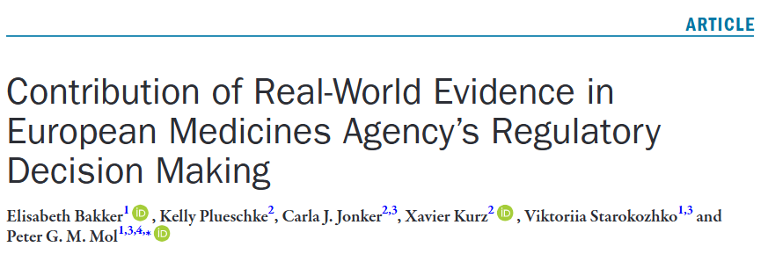

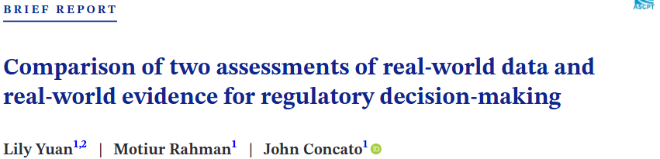
. 2022 Nov 4;113(1):135–151. doi: 10.1002/cpt.2766
CIOMS Working Group XIII consensus report on Real-world data and real-world evidence in regulatory decision making
Current use
https://doi.org/10.1002/cpt.2766
https://doi.org/10.1186/s13023-024-03111-2
https://doi.org/10.1111/cts.13702
Rely (mainly) on public data
Different definitions complicate comparisons between studies and regions

Slide 15
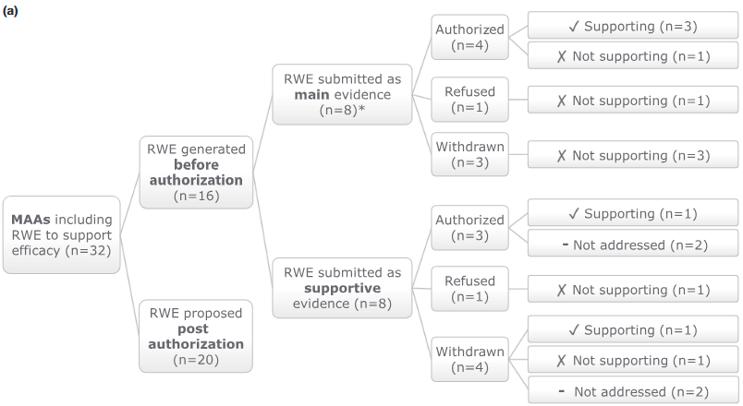
CIOMS Working Group XIII consensus report on
Real-world data and real-world evidence in regulatory decision making
Current use
Pre-authorisation – Postauthorisation
Main – Supportive
Study objectives (disease epidemiology, efficacy/effectiveness, utilisation, safety)
Purpose to use RWD
Data source (medical records, registries, research databases, etc)
Study design (cross-sectional, prospective cohort, retrospective cohort, etc)
Bakker E, et al. Clin Pharmacol Ther. 2023;113(1):135-151

Slide 16
CIOMS Working Group XIII consensus report on Real-world data and real-world evidence in regulatory decision making
Evidentiary requirements and guidance
FDA – Framework (2018) and series of RWE guidances for industry (10 since 2021)
EMA – Data Standardisation Strategy, Reflection paper on use of RWD in non-interventional studies to generate RWE (draft), guidances on post-authorisation and registry studies
Health Canada – Notice „Optimizing the Use of RWE to Inform Regulatory Decision-Making“
NMPA, China
MHLW/PMDA, Japan
ANVISA, Brazil
ICH – Reflection Paper „Pursuing Opportunities for Harmonisation in Using RWD to Generate RWE, with a focus on Effectiveness of Medicines“

Slide 17
CIOMS Working Group XIII consensus report on
Real-world data and real-world evidence in regulatory decision making
Regulators enabling/generating RWE
Regulatory initiatives in data standardisation / data networks / common data models
  US FDA Sentinel (2008)
  EMA/HMA Data Analysis and Real World Interrogation Network (DARWIN EU)
  Catalogs of data sources
RWE generated by regulators (and partners/collaborators)
  Experience widening from safety and drug utilisation
Role in promoting societal agreements on data sharing and access in health dataspace

Slide 18
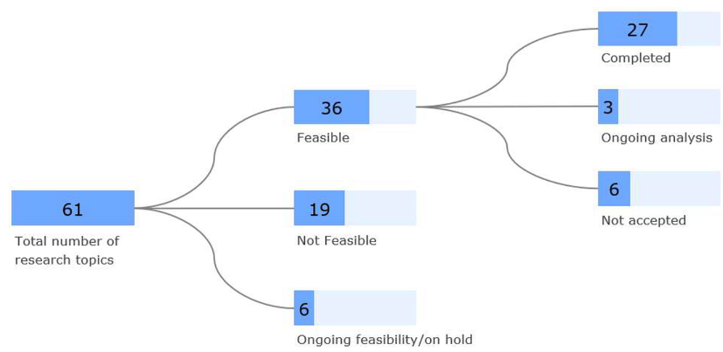
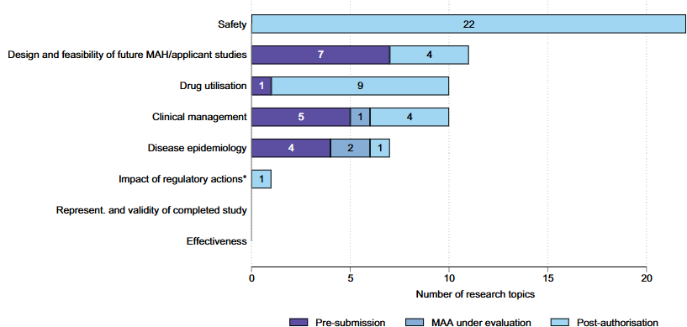
CIOMS Working Group XIII consensus report on
Real-world data and real-world evidence in regulatory decision making
EMA pilot to generate RWE 2021-2023
Prilla S, et al. Clin Pharmacol Ther. 2024;116(5):1188-1197

Slide 19
CIOMS Working Group XIII consensus report on
Real-world data and real-world evidence in regulatory decision making
Summary (the end of the beginning)
Extensive and variable experience of RWD/RWE use in post–authorisation setting
Evolving understanding of data sources, methods and optimal use for RWD/RWE pre- and post-approval – fitness for purpose as a basis
A proactive/prospective view of the medicinal product life-cycle, bridges between regulators and to down-stream decision-makers, willingness to discuss, etc
Regulatory guidance when experience is sufficient to generalise
Regulators’ role in enhancing quality of public data sources, access to data and collaborative generation of RWE

Slide 20
Webinar Series
CIOMS Working Group XIII consensus report on
Real-world data and real-world
evidence in regulatory decision making
Juhaeri Juhaeri
VP & Head, Epidemiology and Benefit - Risk
Sanofi
Bridgewater, New Jersey, USA
Juhaeri.Juhaeri@sanofi.com

Slide 21
CIOMS Working Group XIII consensus report on
Real-world data and real-world evidence in regulatory decision making
Chapter 2. Sources of real-world data
Definitions and scope
Traditional data sources
Emerging data sources

Slide 22
CIOMS Working Group XIII consensus report on Real-world data and real-world evidence in regulatory decision making
Definitions and scope
Definitions
  Real - world data: ”Routinely collected data relating to a patient’s health status or the delivery of health care from a variety of sources other than traditional clinical trials” (EMA)
  Real – world evidence: evidence derived from the review and/or analysis of real-world data
Scope
  Usually includes health care data source, but it’s broader that that
  Spontaneous reporting systems and surveys
  Traditional vs. emerging data sources

Slide 23
CIOMS Working Group XIII consensus report on Real-world data and real-world evidence in regulatory decision making
2.1 Traditional data sources
Existing health care databases
Real-world data sources with primary data collection
Federated systems
Other sources

Slide 24
CIOMS Working Group XIII consensus report on Real-world data and real-world evidence in regulatory decision making
2.1.1. Existing health care databases
Insurance claims, EHR, and registry databases (secondary use/analysis)
Strengths: longitudinal, large number, availability of comparators and confounders, readily available for quicker completion of analyses
Limitations:
  Created for reasons other than research - may not be suitable for certain studies
  Time lag between occurrence of the events and the availability of the data
  Unavailability of sub-groups: older adults, children, and pregnant women
Other challenges
  Repeated analyses
  Risk/signal assessment vs. signal detection
  Accepted more for safety, less for effectiveness

Slide 25
CIOMS Working Group XIII consensus report on Real-world data and real-world evidence in regulatory decision making
2.1.2. Real-world data sources with primary data collection
Existing data sources are not suitable: population, outcomes/exposures of interest, timeline, etc.
Collected on an ad-hoc basis specifically for a particular study: pregnancy registry.
Strengths:
    Potentially more effective for the study questions
    Population studied could be more appropriate
    Measures of exposures, outcomes, and confounders may have a higher validity
Limitations:
  Voluntary basis, problem with accrual
  Long follow-up time
  May not be suitable for other purposes

Slide 26
CIOMS Working Group XIII consensus report on Real-world data and real-world evidence in regulatory decision making
2.1.3. Federated systems
A set of different RWD sources analyzed separately for the same study
RWD sources may use different formats and codes:
  Keep the originals
  Harmonized and standardized– Common Data Model (CDM)
Original formats: European Network of Centres for Pharmacoepidemiology and Pharmacovigilance (ENCePP)
CDMs: Observational Medical Outcomes Partnership, Observational Health Data Sciences and Informatics, European Health Data & Evidence Network, and Data Analysis and Real-World Interrogation Network, US FDA Sentinel

Slide 27
CIOMS Working Group XIII consensus report on Real-world data and real-world evidence in regulatory decision making
2.1.4. Other sources
Spontaneous reporting systems: the UK’s Yellow Card scheme, US FAERS and VAERS, WHO Vigibase, and EudraVigilance
    Individual case reports, spontaneously reported or solicited
    Population (users of medicinal products) from which these events arise are not known – incidence cannot be estimated
    Cross – sectional
    Other limitations: under-reporting, differential – reporting, stimulated reporting, and poor quality of data
    Important source for signal detection since the 1960s
Surveys
    Cross – sectional: US NHANES, surveys of KAB and drug utilization (prescription surveys)
    Useful for prevalence, evaluation of RMM effectiveness

Slide 28
CIOMS Working Group XIII consensus report on Real-world data and real-world evidence in regulatory decision making
2.2. Emerging data sources
Biosensor data
Patient experience data: PROM and patient preference
Text or images from radiology information systems as data
Output from laboratory information systems as data
Output from structured genomics investigation as data
Social media

Slide 29
Webinar Series
CIOMS Working Group XIII consensus report on
Real-world data and real-world
evidence in regulatory decision making
Yoshiko Atsuta, MD, PhD
Scientific Director,
Japanese Data Center for Hematopoietic Cell Transplantation
Professor,
Aichi Medical University

Slide 30
CIOMS Working Group XIII consensus report on
Real-world data and real-world evidence in regulatory decision making
Chapter 3 RWE for regulatory use: key considerations
3.1. Assessing real-world data to generate evidence
3.2. Study design and methods
3.3. Statistical analysis of real-world data
3.4. Evidence-generation, study registration, reporting, documentation and communication
3.5. Reproducibility of real-world data studies
3.6. Agreement between real-world data studies and randomised controlled trials
3.7. Quality tools for real-world data studies and real-world evidence reporting

Slide 31
CIOMS Working Group XIII consensus report on Real-world data and real-world evidence in regulatory decision making
Assessing real-world data to generate evidence (3.1)
Evaluating and selecting and database for specific purpose
  Scientific fitness-for-purpose
Feasibility considerations for evaluation and selection of the database
  Time frame for data availability
  Access to data
  Data feasibility framework (ex. Structured Process to Identify Fit-For-Purpose Data)
Quality consideration for evaluation and selection of the database
  Data integrity
  Transparency for data transformations including mixed data sources
  Regulations and good practice
  Data quality framework
Notes:
Data sources are described in detail in Chapter 2.
Scientific fitness-for-purpose is critical for the evaluation and selection of one or more databases for specific purpose.
Feasibility considerations for evaluation and selection of the database includes time frame for data availability and access to data. Each database has a different data collection schedule and data management plan. Data utilisation may require proposal and approval process, and an agreement or contract may also be required for release of data. with database holders should start in the early phase in study planning.
A data feasibility assessment framework called the Structured Process to Identify Fit-For-Purpose Data is a systematic process for assessing feasibility to determine if a data source is fit for decision making.
Data quality frameworks provide structured approaches to assess the quality of RWD.32-34 The recent European Medicines Agency framework emphasises several key dimensions of data quality that are crucial for evaluating the reliability and usability of RWD including reliability, extensiveness, coherence, timeliness, and relevance

Slide 32

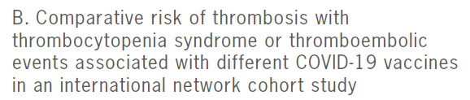
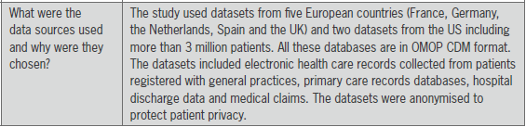

CIOMS Working Group XIII consensus report on Real-world data and real-world evidence in regulatory decision making
Assessing real-world data to generate evidence (3.1)
Single database may not be sufficient for a given research question
Multiple databases may be needed
  Proper work processes for data ingestion
  Harmonisation of datasets into a common data model
  Data linkage needed or not
Notes:
A single database may not be sufficient for a given research question, and multiple databases may be needed. If so, the principles of scientific considerations of fitness-for-purpose apply to each database. When multiple data sources are used, proper work processes for data ingestion and harmonisation of datasets into a common data model are extremely important. If data linkage is needed, the right data elements for patient linking must be present.
Case studies can be found at the end of the report as Appendix 1. in the text case studies are referred such as “Refer to case study B and case study C for the examples”, and by clicking the underlined “case study” the report directs you to the site.

Slide 33
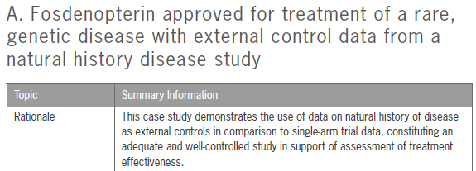
CIOMS Working Group XIII consensus report on Real-world data and real-world evidence in regulatory decision making
Study populations: Design elements and key considerations
Identifying the population that would most benefit from a given therapy
Identifying a clinically relevant anchor point in time
  A new diagnosis, a laboratory value, a surgical procedure/prescription of a new medicine
  Establishes the temporality between potential confounders, the exposure, and the outcome
Race and ethnicity
  Merit additional care in the design and analysis
  Best practices are evolving in this area: expert guidance on measurement, analysis and reporting of race or ethnicity
External controls
  Historical controls
  Contemporaneous control
Notes:
The successful implementation of a real-world study hinges on identifying the population that would most benefit from a given therapy or intervention. This is often achieved by anchoring the start of follow-up on an event that can affect subsequent treatment decisions, as one would do when designing a RCT. This can take the form of a new diagnosis, a laboratory value (e.g. an elevated glycosylated haemoglobin in type 2 diabetes), an intervention (e.g. surgical procedure), or a prescription for a new medicine. It is critical as it establishes the temporality between potential confounders, the exposure, and the outcome.
Constructs such as race and ethnicity merit additional care in the design and analysis of studies to generate RWE. As best practices are evolving in this area, researchers are advised to seek up-to-date expert guidance on measurement, analysis and reporting of race or ethnicity.
Historical controls differ from the contemporaneous controls in terms of timing for cohort entry. To account for any potential temporal changes in disease treatment or outcomes, contemporaneous control cohorts are preferable to historical controls. Cstudy A is an example to utilise of natural history of disease data as external controls in comparison to single arm trial data.

Slide 34

CIOMS Working Group XIII consensus report on Real-world data and real-world evidence in regulatory decision making
Outcome definitions: Design elements and key considerations
Clinical outcomes (most common in RWD studies)
  Reliably recorded outcomes and others
  Overall mortality / depression or pain
  Instruments development
  Diagnostic, response, adverse events criterias
  Composite endpoints with two or more endpoints
  To measure effectiveness anti-diabetic medicine preventing major Cardiovascular events: composite endpoint of stroke, myocardial infarction, and all- cause mortality
  RWD collected according to specific definitions such as patient registries
Patient-reported outcomes
  Directly from the patient
  Health-related quality of life, functional status, pain scores, satisfaction with treatment, and symptom burden
  Questionnaires (including disease- or population-specific) developed. Use validated instruments whenever possible
Surrogate outcomes
  Substitutes for clinical outcomes
  Biomarkers, imaging findings, or laboratory tests
Economic outcomes
  Direct (health resource use), indirect costs (productivity loss), intangible (pain/suffering) costs
  Cost per quality-adjusted life year (QALY) or incremental cost-effectiveness ratio (ICER)
Notes:
Outcome definitions of RWD studies refer to the specific endpoints or measures that are used to evaluate the effectiveness or safety of a particular intervention or exposure in the study population.
Clinical outcomes are the most common category of outcome to be considered in RWD studies and are often related to specific diseases or conditions.
One needs to be cautious when defining outcomes for RWD studies, as clinical outcomes such as overall mortality defined as death from any cause may be more reliably recorded than outcome measures that are more subject to interpretation by individual HCPs such as depression or pain. Instruments such as diagnostic criteria, response criteria, and criteria for adverse events have been
developed to help standardise the assessment of some conditions primarily used in clinical trials.
Composite endpoints, with two or more component endpoints, are often used when the individual events included in the score are rare, and/or when it makes biological and clinical sense to group them. A recent RWD study using EHR emulating a randomised target trial to assess
effectiveness of anti-diabetic medicines on preventing major cardiovascular events in patients
with diabetes used a composite endpoint of stroke, myocardial infarction, and all-cause mortality.
RWD collected according to specific definitions such as patient registries can be an advantage when planning a RWD study. Refer to case study G for post-authorisation safety studies by using patient registry data with internationally harmonised survey items.
A PRO is a measurement of any aspect of a patient’s health status that comes directly from the
patient without the interpretation of the patient’s responses by a physician or anyone else. Examples of PROs include health-related quality of life (HRQoL), functional status, pain scores, satisfaction with treatment, and symptom burden. Many PRO questionnaires, including diasese- or population-specific questionnaires have been developed and validated. Whenever possible, researchers should use PRO instruments that have been validated in the same kinds of people in whom the PRO will be used.
Surrogate outcomes are used as substitutes for clinical outcomes and are thought to predict clinical outcomes. Examples of surrogate outcomes include biomarkers, imaging findings, or laboratory tests considered to be associated with a particular disease or condition. Surrogate endpoints may be used to reduce the follow-up period required to obtain results, thus are more commonly used in clinical trials than in OSs.
three cost components include direct costs related to health resource use, indirect costs related to productivity loss, and sometimes intangible costs (costs related to pain and suffering). The primary outcome of a cost-utility analysis is usually the cost per quality-adjusted life year (QALY), or incremental cost-effectiveness ratio (ICER).

Slide 35
CIOMS Working Group XIII consensus report on Real-world data and real-world evidence in regulatory decision making
Confounders: one of biggest challenges in working with RWD
Confounding is present when the true association between exposure and the outcome is distorted by a third variable: the confounder.
A confounder can be defined as
  A variable for which control by design or analytical adjustment is required to obtain unbiased estimates of the effect of an exposure on the outcome under study.
Confounding factors, if not controlled, may result in:
  An observed association when no real association exists
  No observed association when a true association does exist
  An underestimate of the association
  An overestimate of the association
Confounding by indication
  Occurs when the choice for treatment depends on (known or unrelated) patient characteristics that are associated with the outcome being studied, such as severity of disease.
Time dependent confounding
  Confounders that change over time.
  In contrast to RCTs (researchers can actively minimise treatment non-adherence, loss-to-follow-up, etc), RWD studies are much more likely to face these challenges.
Bias and unmeasured confounding
  Assessment of systematic error (bias) is critical
Notes:
Confounding is one of the biggest challenges in working with RWD and plays an even more significant role when comparing treatment effectiveness with safety.
Confounding is present when the true association between exposure and the outcome is distorted by a third variable: the confounder.
A confounder can be defined as
A variable for which control by design or analytical adjustment is required to obtain unbiased estimates of the effect of an exposure on the outcome under study.
Confounding factors, if not controlled, may result in:
An observed association when no real association exists
No observed association when a true association does exist
An underestimate of the association
An overestimate of the association
Confounding by indication
Confounding by indication occurs when the choice for treatment depends on (known or unrelated) patient characteristics that are associated with the outcome being studied, such as severity of disease.
Time dependent confounding
Time-dependent confounding refers to confounders that change over time. In contrast to RCTs where researchers can actively minimise treatment non-adherence, loss-to-follow-up, and some intercurrent events, RWD studies are much more likely to face these challenges.
When using RWD, assessment of systematic error (bias) is critical for a study aimed at evaluating a medicinal product's treatment effect. The role of bias in epidemiology and pharmacoepidemiology has been described in many guidelines and reference works.

Slide 36
CIOMS Working Group XIII consensus report on Real-world data and real-world evidence in regulatory decision making
Study design considerations in context of randomised controlled trials
Traditional randomised controlled trials using real-world data
  RWD use in RCT planning: To assess enrollment criteria and trial feasibility, to support selection of trial sites
  RWD elements outside of the trial infrastructure to capture additional data: Routine EHRs, laboratory and pharmacy data
Interventional trials in clinical practice settings
  Pragmatic randomised clinical trials
  A broader and more diverse study population of patients who are eligible to receive study interventions as part of routine clinical practice. Research participants recruited from clinical practice settings
  Research participants are recruited from clinical practice settings. Primary and secondary outcomes could be collected from claims or EHRs, or collected through limited electronic case report forms
  External controls
  Single-group trial with external control group derived from RWD
  Regulations and guidance document
Notes:
RWD can be used in traditional RCT
RWD use in RCT planning include RWD used to assess enrollment criteria and trial feasibility, and RWD used to support selection
of trial sites
RWD elements outside of the trial infrastructure can be used to capture additional data. Examples include Routine EHRs, laboratory and pharmacy data.
Pragmatic randomised clinical trials are largely thought to answer important and relevant questions about the real-world effects of treatments in post-approval routine clinical practice settings. They typically include a broader and more diverse study population of patients who are eligible to receive study interventions as part of routine clinical practice. Research participants are recruited from clinical practice settings. Primary and secondary outcomes could be collected from claims or EHRs, or collected through limited electronic case report forms

Slide 37
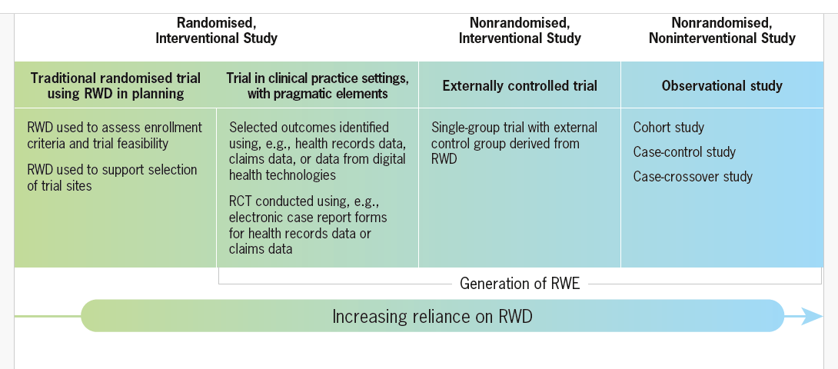
CIOMS Working Group XIII consensus report on Real-world data and real-world evidence in regulatory decision making
Reliance on RWD in representative types of study design
Source: (Figure modified with permission) Concato J, Corrigan-Curay J. Real-world evidence—Where are we now? New Engl J Med 2022;1680-1682. DOI: 10.1056/NEJMp2200089.

Slide 38


CIOMS Working Group XIII consensus report on Real-world data and real-world evidence in regulatory decision making
Statistical analysis of real-world data
Descriptive statistics and unadjusted analysis
  Summarise and describe basic features of the population - can be used to assess imbalances between the study groups
  Causal diagrams
Adjusted analysis
  Regression models
  Estimation of treatment effects adjusted for potential cofounding variables
  Prognostic factor studies
Competing risk events
  An event that precludes the outcome of interest from occurring for that individual
Time-dependent covariates and time-varying effects
  Variables whose value may change after the participant enters the study
Missing data
  Values that are not available and that would be meaningful for analysis if they were available
  STRATOS initiative: guidance framework
Notes:
Descriptive statistics are used to summarise and describe the basic features of the population, and can be used to assess imbalances between the study groups. Univariate or unadjusted analysis can be used to provide a preliminary assessment of which covariates are associated with exposure and/or study outcomes. Causal diagrams are also an important tool for identifying the role that covariates play given our understanding of the temporal and causal relationships among these measures, the exposure, and outcomes of interest.
Regression models are often used to estimate treatment effects adjusted or controlled for potential confounding variables. Refer to case study E for adjusted analysis by using Cox model.
Regression models are also often used in prognostic factor studies designed to determine patient, disease, and exposure/treatment characteristics, which influence clinical outcomes of the exposure/treatment.
A competing risk is an event that precludes the outcome of interest from occurring for that individual. Appropriate handling of competing risks is critical for the analysis plan.
Most of the variables discussed in the previous sections are known when observation of the participants begins, or at the time origin. These are time-fixed covariates. Time-dependent or time-varying covariates are those whose value may change after the participant enters the study. Examples include continuous variables such as white blood cell or neutrophil count after starting chemotherapy, or binary variables indicating whether the patient developed febrile neutropenia after starting therapy or whether the patient is discharged by a given time. Refer to case study D for Cox regression models with time-varying variables for potential influencing factors to calculate hazard ratios for risk of cancer.
Incomplete data is a reality in all research but may be more extensive outside traditional randomized clinical trials. Missing data are defined as values that are not available and that would be meaningful for analysis if they were available. Recently, STRATOS (STRengthening Analytical Thinking for Observational Studies) initiative has published guidance framework for the treatment and reporting of missing data in OSs

Slide 39
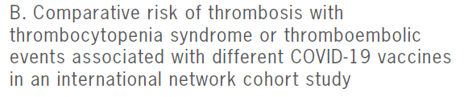

CIOMS Working Group XIII consensus report on Real-world data and real-world evidence in regulatory decision making
Matching approaches for comparators: focusing on PS-based methods
Use of propensity score for matching to control for confounding (Rosenbaum and Rubin)
  Calculated by fitting a logistic regression model that predicts the probability of treatment assignment based on the covariates
  Can be used in sub-classification or stratification, matching, and weighting, and further adjusted using regression adjustment
Matching
  Exposed vs. unexposed
  Balance between the groups can be presented graphically or by comparing standardized differences across groups
  “Emulated RCT”
Weighting
  Each individual’s data is weighted by the inverse of their probability (IPTW) of the treatment to estimate the average treatment effect (ATE) in the total population
Notes:
The use of the propensity score for matching to control for confounding was proposed by Rosenbaum and Rubin. It is typically calculated by fitting a logistic regression model that predicts the probability of treatment assignment based on the covariates. Propensity scores can be used in sub-classification or stratification, matching, and weighting, and further adjusted using regression adjustment.
Matching is primarily used when examining the effect of a point exposure that has two exposure levels, i.e. exposed and unexposed, to reduce the bias by reducing imbalance in the matched sample. The balance between the groups can be presented graphically or by comparing standardised differences across groups, which allows a reader to assess the balance in a similar manner to comparing randomised groups from a randomised clinical trial, or a “emulated RCT” Refer to case study B for using propensity scores for matching.
When using propensity score weighting, each individual’s data is weighted by the inverse of their probability (IPTW) of the treatment they actually received to estimate the average treatment effect (ATE) in the total population.

Slide 40

CIOMS Working Group XIII consensus report on Real-world data and real-world evidence in regulatory decision making
Principles of sensitivity analysis
Subgroup analysis
Sensitivity analysis
  A series of analyses conducted to explore the robustness of inferences from the main estimator to deviations from its underlying causal assumptions and limitations in the data
  Can help address these issues for different scenarios, assumptions, and sources of variabilitythe covariates
Subgroup analysis
  Subpopulations: aediatric, geriatric, and racial/ethnic subgroups, or patients with comorbidities
  Subpopulations can be useful in sensitivity analysis to examine the robustness of study findings across different populations.
  Can indicate the presence of effect measure modification, emphasising the need to acknowledge population heterogeneity in interpreting results.
Notes:
Sensitivity analysis is a series of analyses conducted to explore the robustness of inferences from the main estimator to deviations from its underlying causal assumptions and limitations in the data; thus, it can help address these issues for different scenarios, assumptions, and sources of variability
Refer to case study H for sensitivity analyses to investigate the robustness of results.
Subpopulations such as paediatric, geriatric, and racial/ethnic subgroups, or patients with comorbidities can be useful in sensitivity analysis to examine the robustness of study findings across different populations. It also can indicate the presence of effect measure modification, emphasising the need to acknowledge population heterogeneity in interpreting results.

Slide 41
CIOMS Working Group XIII consensus report on Real-world data and real-world evidence in regulatory decision making
Real-world evidence reporting-transparency and trust
Regulatory approvals based on RWE
Created an urgency to develop generally accepted processes that promote trust in the evidence-generation
Registration of RWD studies
Quality tools for RWD studies and RWE reporting
  STROBE
  RECORD-PE
  GRADE
  ReQueST
Agreement between RWD studies and RCT
  RCT-DUPLICATE initiative
  (Randomized, Controlled Trials Duplicated Using Prospective Longitudinal Insurance Claims: Applying Techniques of Epidemiology)
When the data and design are fit-for-purpose, non-randomised database studies can reach similar conclusions about drug effects as randomised trials.
The real benefit of non-randomised, non-interventional RWD studies is in how they can complement rather than replace evidence from RCTs in extending knowledge about the effects of medical products in post-approval settings.
Notes:
Recent regulatory approvals based on RWE created an urgency to develop generally accepted processes that promote trust in the evidence-generation process.
Registration of RWD studies has been proposed to improve transparency, trust, and research replicability. In the CIOMS report, quality tools for RWD studies and RWE reporting are introduced
In 2020, an extensive US-based study team launched the RCT DUPLICATE initiative (Randomized, Controlled Trials Duplicated Using Prospective Longitudinal Insurance Claims: Applying Techniques of Epidemiology) to compare the findings of RCTs relevant to regulatory decision making with the findings of noninterventional RWE that emulate the trial design as closely as possible in a consistent, transparent, and reproducible process that would be acceptable to regulators.
Other similar RCT emulation projects have also found that when the data and design are fit-for-purpose, non-randomised database studies can reach similar conclusions about drug effects as randomised trials.
The real benefit of non-randomised, non-interventional RWD studies is in how they can complement rather than replace evidence from RCTs in extending knowledge about the effects of medical products in post-approval settings.

Slide 42
Webinar Series
CIOMS Working Group XIII consensus report on
Real-world data and real-world
evidence in regulatory decision making
David Townend
Professor of Health and Life Sciences Law
The City Law School
City St George’s, University of London
david.townend@city.ac.uk

Slide 43
CIOMS Working Group XIII consensus report on Real-world data and real-world evidence in regulatory decision making
Chapter 4: Ethics and Governance
Ethics of using and not using RWE and RWD
Data Protection and RWE and RWD
Moving forward

Slide 44
CIOMS Working Group XIII consensus report on Real-world data and real-world evidence in regulatory decision making
Chapter 4: Ethics and Governance
Ethics of using and not using RWE and RWD
  What are the harms that are in play?
    Reliability questions
      Reliability gaps that RWE and RWD addresses
      Reliability gaps that RCTs address

Slide 45
CIOMS Working Group XIII consensus report on Real-world data and real-world evidence in regulatory decision making
Chapter 4: Ethics and Governance
Ethics of using and not using RWE and RWD
  What are the harms that are in play?
    Privacy and confidentiality
    Is informed consent essential for participation in RWE and RWD?

Slide 46
CIOMS Working Group XIII consensus report on Real-world data and real-world evidence in regulatory decision making
Chapter 4: Ethics and Governance
Data Protection and RWE and RWD (example of the EU GDPR 2016/679)
  How is RWE and RWD a personal data protection problem?
    Secondary use of already gathered data
      Compatibility with the legal basis for processing (Articles 6 and 9)
      Informing data subjects of the new processing (Articles 13 and 14)

Slide 47
CIOMS Working Group XIII consensus report on Real-world data and real-world evidence in regulatory decision making
Chapter 4: Ethics and Governance
Moving forward
  How do people, patients and not-yet-patients, view their privacy against other priorities?
  What technical safeguards can be developed?
  Two linked political debates:
    Informed consent
    Interpretations of the data protection legislation

Slide 48
Webinar Series
CIOMS Working Group XIII consensus report on
Real-world data and real-world
evidence in regulatory decision making
Sean Hennessy
Professor of Epidemiology,
University of Pennsylvania
Philadelphia, USA
hennessy@upenn.edu

Slide 49
CIOMS Working Group XIII consensus report on
Real-world data and real-world evidence in regulatory decision making
Conclusions
Uses of RWE are increasing, mostly in ways that complement rather than replace RCTs.
Sources of RWD are becoming more diverse & widespread.
Methods to derive valid, actionable RWE from RWD are advancing steadily.
Ethics and governance have progressed, but additional work and harmonization are still needed.

Slide 50
CIOMS Working Group XIII consensus report on
Real-world data and real-world evidence in regulatory decision making

